Slide 1
Chapter 1 An Overview of Marketing

Slide 2
Learning Outcomes
Explain the importance of developing new products and describe the six categories of new products
Explain the steps in the new-product development process
Understand why some products succeed and others fail

Slide 3
Learning Outcomes (continued)
Discuss global issues in new-product development
Explain the diffusion process through which new products are adopted
Explain the concept of product life cycles

Slide 4
New Products
LO 1
Important to sustain growth, increase revenues and profits, and replace obsolete items
Categories of new products
New-to-the-world
New product lines
Product line additions
Improvements or revisions
Repositioned products
Lower-priced products
Notes:
The introduction of a new product is a monumental undertaking with a lot of open-ended questions—even for an established, multi-billion dollar company.
The meaning of the term new product varies widely. The term actually has several correct definitions. There are six categories of new products:
• New-to-the-world products (or discontinuous innovations) create an entirely new market and are the smallest category of new products.
• New product lines allow a firm to enter an established market.
• Additions to existing product lines include new products that supplement a firm’s established product line.
• Improvements or revisions of existing products may be significantly or only slightly changed.
• Repositioned products are targeted at new markets or market segments.
• Lower-priced products provide performance similar to competing brands at a lower price.

Slide 5
Idea Screening and Concept Test
LO 2
Screening: First filter in the product development process
Eliminates ideas that are inconsistent with the organization’s new-product strategy or are inappropriate for some other reason
Concept test: Test to evaluate a new-product idea, usually before any prototype has been created
Notes:
After new ideas have been generated, they pass through screening, which is the first filter in the product development process.
Concept tests are considered fairly good predictors of success for line extensions. They have also been relatively precise predictors of success for new products that are not copycat items, are not easily classified into existing product categories, and do not require major changes in consumer behavior.

Slide 6
Considerations in Business Analysis Stage
LO 2
Demand
Cost
Sales
Profitability
Notes:
New-product ideas that survive the initial screening process move to the business analysis stage, where preliminary figures for demand, cost, sales, and profitability are calculated.

Slide 7
Development
LO 2
Stage in the product development process that includes:
Developing a prototype
Sketching a marketing strategy
Deciding on packaging, branding, and labeling
Mapping out promotion, price, and distribution strategy
Examining manufacturing feasibility
Notes:
The development stage can last a long time and thus be very expensive. It took ten years to develop Crest toothpaste, fifteen years to develop the Polaroid Colorpack camera and the Xerox copy machine, eighteen years to develop Minute Rice, and fifty-one years to develop the television.

Slide 8
Simultaneous Product Development
LO 2
Team-oriented approach to new-product development
Test marketing: Limited introduction of a product and a marketing program to determine the reactions of potential customers in a market situation
Notes:
The development process works best when all the involved areas (marketing, R&D, engineering, production, and suppliers) work together rather than sequentially. This product is known as simultaneous product development.
This approach allows firms to shorten the development process and reduce costs.
The Internet is a useful tool for implementing simultaneous product development, particularly for global efforts. Global R&D is important because large companies have become global and focus on multiple markets. Also, companies want to tap into the world’s best talent.

Slide 9
Commercialization
LO 2
Decision to market a product involves:
Ordering production materials and equipment
Starting production
Building inventories
Shipping the product to field distribution points
Training the sales force
Announcing the product to the trade
Advertising to potential customers
Notes:
The best-managed global firms leverage their global networks by sharing best practices, knowledge, and technology.

Slide 10
Reasons for Product Failure
LO 3
No discernible benefit compared to existing products
Poor match between product features and customer desires
Overestimation of market size
Incorrect targeting
Too high or too low prices
Inadequate distribution
Notes:
Products fail for a number of reasons:
• One common reason is that they simply do not offer any discernible benefit compared to existing products.
• Another commonly cited factor in new product failures is a poor match between product features and customer desires.
• Other reasons for failure include overestimation of market size, incorrect targeting or positioning, a price too high or too low, inadequate distribution, poor promotion, or simply, an inferior product.
Absolute failure occurs when a company cannot recoup its development, marketing, and production costs—the product actually loses money for the company.
A relative product failure results when the product returns a profit but fails to achieve sales, profit, or market share goals.

Slide 11
Global Issues in New-Product Development
LO 4
Globalization of markets and competition provides a reason for multinational firms to consider new-product development from a worldwide perspective
Succeeding in some countries often requires companies to develop products that meet the unique needs of these populations
Notes:
A firm that starts with a global strategy is better able to develop products that are marketable worldwide.
In many multinational corporations, every product is developed for potential worldwide distribution, and unique market requirements are built in whenever possible.
Some global marketers design their products to meet regulations in their major markets and then, if necessary, meet smaller markets’ requirements country by country.

Slide 12
Diffusion
LO 5
Process by which the adoption of an innovation spreads
Categories of innovators
Innovators
Early adopters
Early majority
Late majority
Laggards
Notes:
Five categories of adopters participate in the diffusion process:
Innovators - The first 2.5 percent who adopt the product. Many are obsessive about trying new ideas and products.
Early adopters - The next 13.5 percent to adopt the product. They are oriented to the community and rely on group norms and values.
Early majority - The next 34 percent to adopt. They weigh the pros and cons before adopting a new product and rely on group information.
Late majority - The next 34 percent to adopt. They adopt a new product because most of their friends have already adopted it.
Laggards - The final 16 percent to adopt. By the time laggards adopt an innovation, it has probably been outmoded. Marketers typically ignore laggards, who do not seem to be motivated by promotion and personal selling.

Slide 13
Product Characteristics and the Rate of Adoption
LO 5
Complexity
Compatibility
Relative advantage
Observability
Trialability
Notes:
Five product characteristics can be used to predict and explain the rate of acceptance and diffusion of a new product:
Complexity - The more complex the product, the slower is its diffusion.
Compatibility - Incompatible products diffuse more slowly than compatible products.
Relative advantage - The degree to which a product is perceived as superior to existing substitutes.
Observability - The degree to which the benefits or other results of using the products can be observed by others and communicated to target customers.
Trialability - The degree to which a product can be tried on a limited basis.

Slide 14
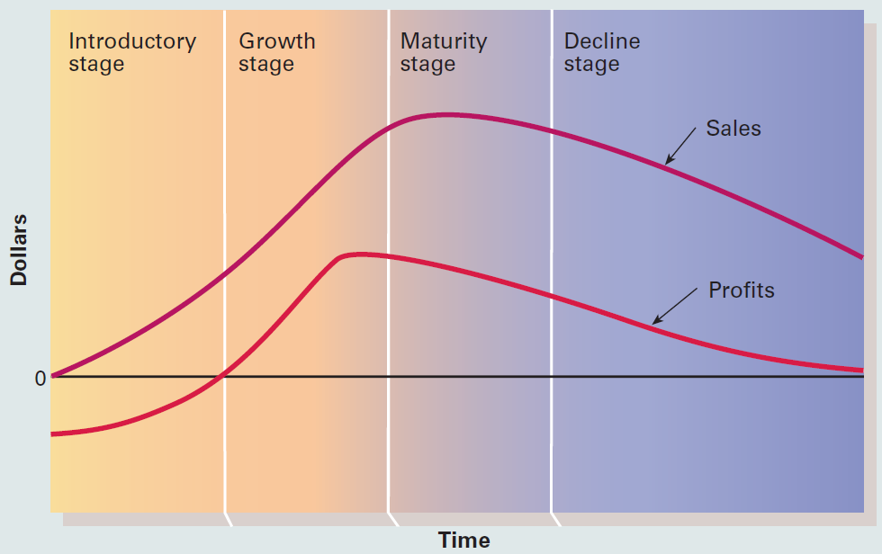
11. 2 Four Stages of the Product Life Cycle
LO 6
Notes:
The product life cycle (PLC) is a widely familiar concept in marketing and is considered a useful marketing management tool. However, some critics have challenged the theoretical basis and managerial value of the PLC.
The product life cycle traces the stages of a product’s acceptance from its introduction to its decline.
The PLC concept can be used to analyze a brand, a product form, or a product category.

Slide 15
Key Terms
New product
New-product strategy
Product development
Brainstorming
Screening
Concept test
Business analysis
Development
Simultaneous product development
Test marketing
Simulated (laboratory) market testing
Commercialization
Innovation
Diffusion
Product life cycle (PLC)
Product category
Introductory stage
Growth stage
Maturity stage
Decline stage

Slide 16
Summary
New products are important to sustain growth, increase revenues and profits, and replace obsolete items
Globalization of markets and competition provides a reason for multinational firms to consider new-product development from a worldwide perspective
Managers have a greater chance of marketing products if they understand how consumers learn about and adopt products

