Slide 1
Chapter 19 - Pricing Concepts

Slide 2
Learning Outcomes
Discuss the importance of pricing decisions to the economy and to the individual firm
List and explain a variety of pricing objectives
Explain the role of demand in price determination
Understand the concepts of dynamic pricing and yield management systems
Describe cost-oriented pricing strategies

Slide 3
Learning Outcomes (continued)
Demonstrate how the product life cycle, competition, distribution and promotion strategies, customer demands, the Internet and extranets, and perceptions of quality can affect price
Describe the procedure for setting the right price
Identify the legal constraints on pricing decisions
Explain how discounts, geographic pricing, and other pricing tactics can be used to fine-tune a base price

Slide 4
Price
LO 1
Amount that is given up in an exchange to acquire a good or service
Effects
Measure of sacrifice
Information cue
Importance to managers
Revenue: Price charged to customers multiplied by the number of units sold
Profit: Revenue minus expenses
Notes:
Price means one thing to the consumer and another to the seller. To the consumer, the price is the cost of something; to the seller, price is the source of profits.
Marketing mangers find the task of setting prices a challenge.
Price plays two roles in the evaluation of product alternatives: as a measure of sacrifice and as an information cue.
Sacrifice can be money used to get a good or service or the time lost while waiting to acquire the good or service.
Higher price can convey higher product quality and the prominence and status of the purchaser.
Consumers are interested in obtaining a reasonable price, which means a perceived reasonable value at the time of the transaction.
Prices are the key to revenues, which in turn are the key to profits for an organization.
Revenue is what pays for every activity of the company. What’s left over is profit. The price is set to earn a profit for the company.

Slide 5
Pricing Objectives
LO 2
Need to be specific, attainable, and measurable
Categories
Profit oriented
Sales oriented
Status quo

Slide 6
Nature of Demand
LO 3
Lower the price, higher the demand for a product or service and vice versa
At higher prices, supply increases as manufacturers earn more capital and vice versa
Notes:
After pricing goals are established, specific prices are set.
Pricing depends on the demand for a good or service and the cost to the seller for that good or service.
Demand is the quantity of a product that will be sold in the market at various prices for a specified period.
Supply is the quantity of a product that will be offered to the market by a supplier at various prices for a specified period.

Slide 7
Elasticity of Demand
LO 3
Consumers’ responsiveness or sensitivity to changes in price
Elastic demand
Situation in which consumer demand is sensitive to changes in price
Inelastic demand
Situation in which an increase or a decrease in price will not significantly affect the demand for a product

Slide 8
Dynamic Pricing and Yield Management System (YMS)
LO 4
Dynamic pricing: Ability to change prices very quickly in real time
Aids brick-and-mortar retailers to compete more efficiently with online alternatives
Yield management system (YMS)
Uses complex mathematical software to profitably fill unused capacity by:
Discounting early purchases
Limiting early sales at discounted prices and overbooking capacity
Notes:
More and more companies are turning to dynamic pricing to help adjust prices.
Yield management systems (YMS) were developed in the airline industry to profitably fill unused capacity. YMS has spread beyond the service industries and is being used by companies to set prices based on a number of variables.

Slide 9
Types of Cost
LO 5
Variable cost
Cost that varies with changes in the level of output
Fixed cost
Cost that does not change as output is increased or decreased
Notes:
Sometimes the importance of demand is ignored when prices are decided largely or solely on the basis of costs.
Prices set on the basis of cost may be too high for the target market, and if prices are set too low, the firm will earn a lower return than it should.
Variable and fixed costs are important aspects of price determination.

Slide 10
Markup Pricing and Break-Even Analysis
LO 5
Markup pricing
Cost of buying the product from the producer, plus amounts for profit and for expenses not otherwise accounted for
Break-even analysis
Determines what sales volume must be reached before total revenue equals total costs
Notes:
Markup pricing is the most popular method to establish a selling price. Instead of using the costs of production to set price, markup pricing uses the costs of buying the product from the producer, plus amounts for profit and expenses. The total determines the selling price.
To use markup based on cost or selling price effectively, the marketing manager must calculate an adequate gross margin
Margin must provide adequate funds to cover selling expenses and profit
Break-even analysis provides a quick estimate of:
How much the firm must sell to break even
How much profit can be earned if a higher sales volume is obtained

Slide 11
Other Determinants of Price
LO 6
Stages in the product life cycle
Competition, price matching, and customer loyalty
Distribution strategy
Impact of the Internet and extranets
Promotion strategy
Demands of large customers
Relationship of price to quality
Notes:
Following are the other determinants of price:
The demand for a product and the competitive conditions tend to change as a product moves through its life cycle. This leads to price changes.
Competition varies during the product life cycle. Although a firm may not have competition at first, the high prices it charges may induce other firms to enter the market and sometimes competition can lead to price wars.
A competitor’s prices can be countered using price matching. Price matching can also be a tool for building customer loyalty.
An effective distribution network helps overcome minor flaws in the marketing mix.
The Internet, extranets (private electronic networks), and wireless setups allow sellers to collect detailed data about customers, which enable them to tailor products and prices.
Pricing is used as a promotional tool to increase consumer interest.
Specific pricing demands from large customers such as department stores may affect the profits of the manufacturers.
Price promotions of higher priced, higher quality brands and products such as perfumes and fine watches tend to attract more business.

Slide 12
Distribution Strategies
LO 6
Adequate distribution for a new product can be attained by:
Offering a larger-than-usual profit margin to distributors
Giving distributors a large trade allowance to help:
Offset the costs of promotion
Stimulate demand at the retail level

Slide 13
Impact of the Internet and Extranets
LO 6
Using shopping bots
Shopping bots - Searches the web for the best prices for a particular item that one wishes to purchase
Give pricing power to the consumer
Internet auctions
Business-to-business auctions may be the dominant form in the future
Notes:
The Internet connects sellers and buyers quickly and allows product and price comparison, putting them in a better bargaining position.
Extranets are private electronic networks that link companies with their suppliers and customers.
The two types of shopping bots are broad-based types and niche-oriented types. The broad-based type searches a wide range of product categories, and the niche-oriented type searches for prices for only one type of product.

Slide 14
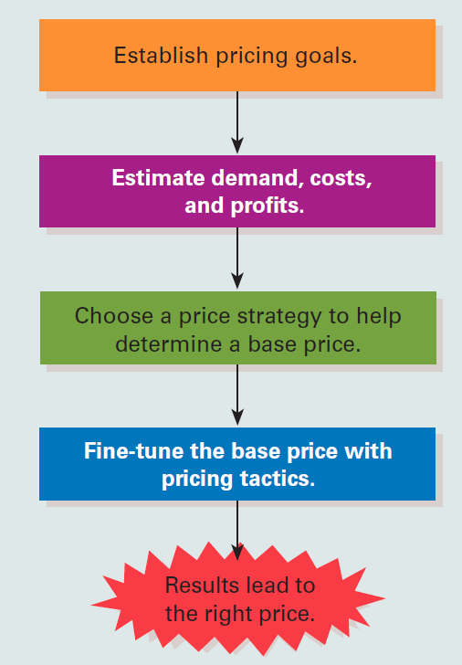
19.3 Steps in Setting the Right Price on a Product
LO 7

Slide 15
Price Strategy - Approaches
LO 7
Price skimming
Penetration pricing
Status quo pricing
Notes:
Price strategy is a basic, long-term pricing framework that establishes initial price for a product and the intended direction for price movements over the product life cycle.
It sets a competitive price in a specific market segment based on a well-defined positioning strategy.

Slide 16
Illegal Pricing Strategies
LO 8
Unfair trade practices
Price fixing
Price discrimination
Predatory pricing

Slide 17
Unfair Trade Practices, Price Fixing, and Predatory Pricing
LO 8
Unfair trade practice acts
Laws that prohibit wholesalers and retailers from selling below cost
Price fixing
Agreement between two or more firms on the price they will charge for a product
Predatory pricing
Practice of charging a very low price for a product with an intent to drive competitors out of business or out of a market
Notes:
In over half the states, unfair trade practice acts put a floor under wholesale and retail prices. Selling below cost is illegal in some states. Wholesalers and retailers must take a certain minimum percentage markup on their combined merchandise cost and transportation cost.
The most common markup figures are 6 percent at the retail level and 2 percent at the wholesale level. If a specific wholesaler or retailer can provide “conclusive proof” that operating costs are lower than the minimum required figure, lower prices may be allowed.
The intent of unfair trade practice acts is to protect small firms from retail giants like Walmart and Target, which operate efficiently on razor-thin profit margins. State enforcement of unfair trade practice laws has generally been lax because low prices benefit local consumers.
Price fixing and predatory pricing are illegal under the Sherman Act and the Federal Trade Commission Act.
Discussion Question/Team Activity
Research examples of cases tried under the Sherman and Federal Trade Commission Acts.

Slide 18
Robinson-Patman Act of 1936
LO 8
Prohibits:
Firms from selling similar commodities at different prices to two or more different buyers within a short time
Sellers from offering two buyers different supplementary services
Buyers from using their purchasing power to force sellers into granting discriminatory prices or services

Slide 19
Tactics for Fine-Tuning the Base Price
LO 9
Discounts, allowances, and rebates
Geographic pricing
Other pricing strategies
Value-based pricing
Notes:
The base price is the general price level at which the company expects to sell a good or service. The general price level is correlated with the pricing policy: above the market, at the market, or below the market. The final step is to fine-tune the base price.
Fine-tuning techniques include discounts, geographic pricing, and other pricing tactics.

Slide 20
Consumer Penalty
LO 9
Extra fee paid by the consumer for violating the terms of the purchase agreement
Businesses impose penalties when:
They suffer an irrevocable revenue loss
They incur significant additional transaction costs if customers are unable or unwilling to complete their purchase obligations
Notes:
More businesses are adopting consumer penalties—extra fees paid by consumers for violating the terms of a purchase agreement.
Discussion Question/Team Activity
Have your students brainstorm a list of common consumer penalties in different industries.

Slide 21
Key Terms
Price
Revenue
Profit
Return on investment (ROI)
Market share
Status quo pricing
Demand
Supply
Elasticity of demand
Elastic demand
Inelastic demand
Dynamic pricing
Yield management systems (YMS)
Variable cost
Fixed cost
Markup pricing
Keystoning
Break-even analysis
Extranet
Price strategy

Slide 22
Key Terms (continued 1)
Price skimming
Penetration pricing
Unfair trade practice acts
Price fixing
Predatory pricing
Base price
Quantity discount
Cumulative quantity discount
Noncumulative quantity discount
Cash discount
Functional discount (trade discount)
Seasonal discount
Promotional allowance (trade allowance)
Rebate
Value-based pricing
FOB origin pricing

Slide 23
Key Terms (continued 2)
Uniform delivered pricing
Zone pricing
Freight absorption pricing
Basing-point pricing
Single-price tactic
Flexible pricing (variable pricing)
Price lining
Leader pricing (loss-leader pricing)
Bait pricing
Odd–even pricing (psychological pricing)
Price bundling
Two-part pricing
Consumer penalty

Slide 24
Summary
Price set for each product depends on the demand and the cost to the seller
Markup pricing and break-even pricing are approaches to determine price based on cost
Tactics for fine-tuning the base price include various sorts of discounts, geographic pricing, and other pricing strategies

