Slide 1
Overview of Selling

Slide 2
Learning Objectives
Define personal selling and describe its unique characteristics as a marketing communications tool
Distinguish between transaction-focused traditional selling and trust-based relationship selling, with the latter focusing on customer value and sales dialogue
Understand sales professionalism as a key driver in the continued evolution of personal selling

Slide 3
Learning Objectives (continued)
Explain the contributions of personal selling to society, business firms, and customers
Discuss five alternative approaches to selling
6 Understand the sales process as a series of interrelated steps
7 Describe several aspects of sales careers, types of selling jobs, and the key qualifications needed for sales success

Slide 4
Personal Selling
Marketing tool that focuses on interpersonal interactions between buyers and sellers
To initiate, develop, and enhance customer relationships
Trust-based relationship selling
Requires salespeople to earn trust, meet customer needs, and contribute to the creation, communication, and delivery of customer value

Slide 5
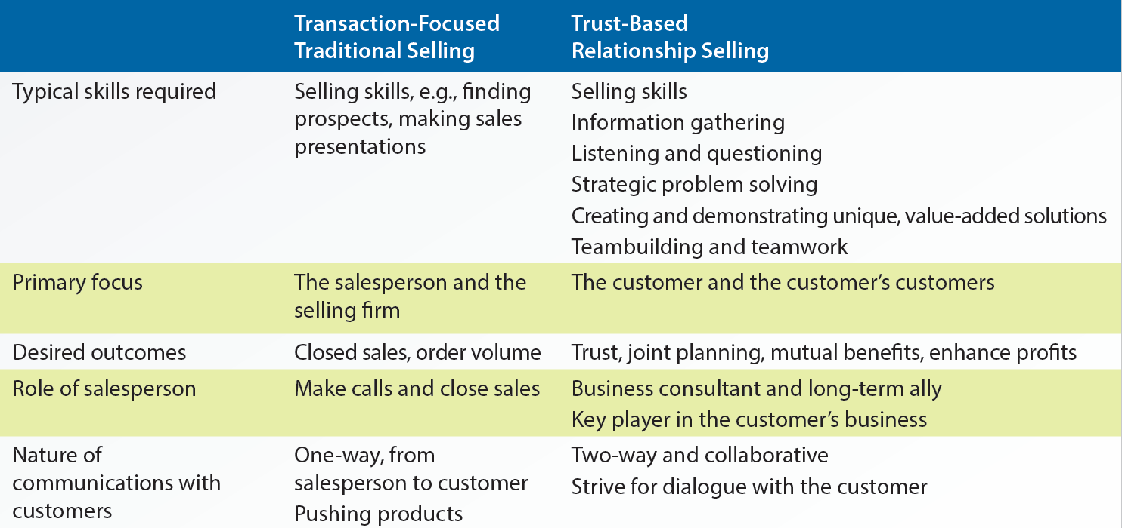
1.1 Comparison of Transaction-Focused Traditional Selling with Trust-Based Relationship Selling

Slide 6
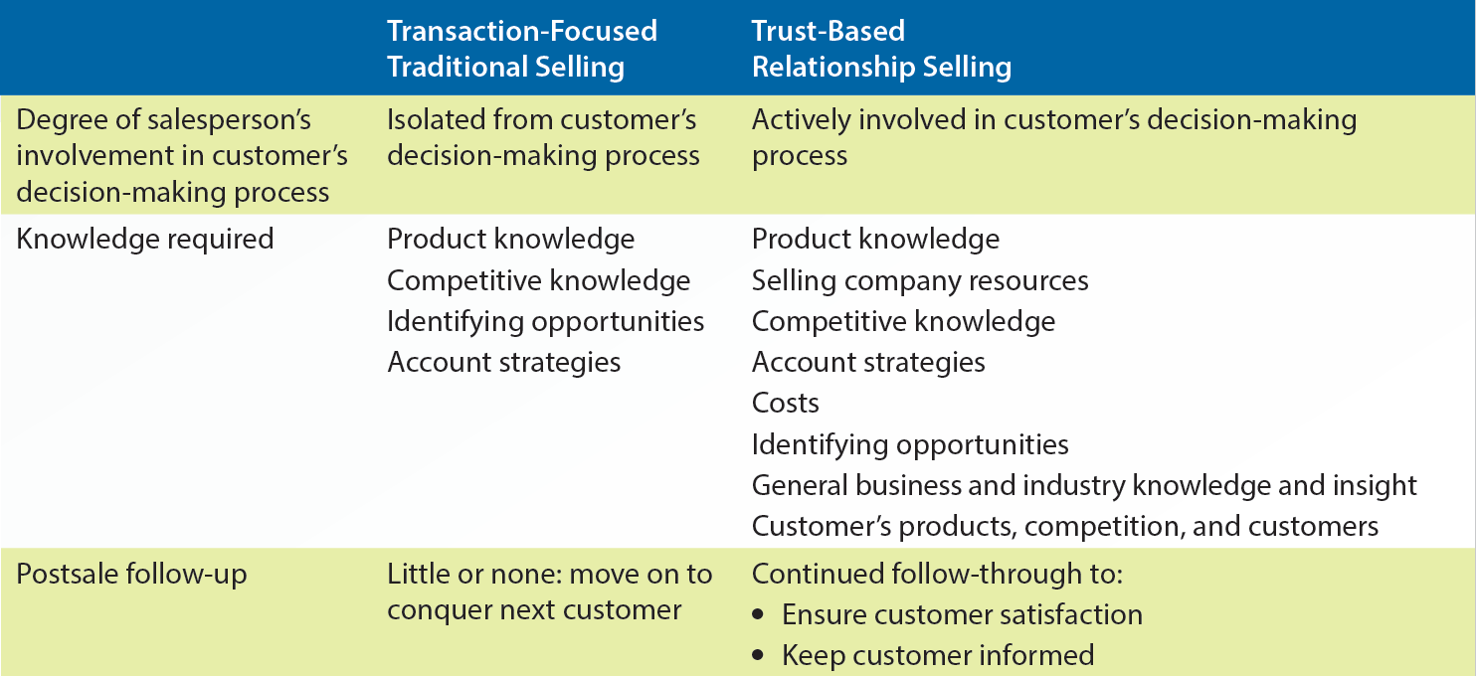
1.1 Comparison of Transaction-Focused Traditional Selling with Trust-Based Relationship Selling (continued)

Slide 7
Customer Value
Customers’ perception of what they obtain in exchange for what they have to give up
Involves addressing questions such as:
Does the salesperson do a good job in helping the customer?
Is the salesperson dependable?
Is the salesperson’s company easy to work with?
Does the sales representative understand the customer’s business and his/her industry?

Slide 8
Sales Dialogue with a Prospective Customer
Series of conversations between buyers and sellers to forge a relationship for:
Determining the need for further attention
Clarifying the situation and buying processes
Discovering unique needs
Determining priorities

Slide 9
Sales Dialogue with a Prospective Customer (continued)
Communicating how the sales organization can create and deliver customer value
Negotiating a business deal and earning a commitment from the customer
Making the customer aware of additional opportunities to increase the value received
Assessing sales organization performance to ensure continuous improvement

Slide 10
Evolution of Professional Selling
Sales professionalism: Customer-oriented approach
Uses truthful, non-manipulative tactics to satisfy long-term needs of the customer and the selling firm
Meets professional criteria of:
Specialized knowledge
Contribution to society
Defined culture and organization of colleagues
Unique set of skills

Slide 11
Contributions of Personal Selling
Salespeople help in:
Stimulating the economy
Diffusion of innovation: Distribution of new products, services, and ideas to the members of society
Generating revenue and providing feedback through research
Maintaining long-term relationships with customers
Providing expertise and coordinating activities with the selling firm

Slide 12
Alternative Personal Selling Approaches
Adaptive selling: Ability of salespeople to change their sales messages based on various customer situations
Stimulus response
Mental states
Need satisfaction
Problem solving
Consultative selling

Slide 13
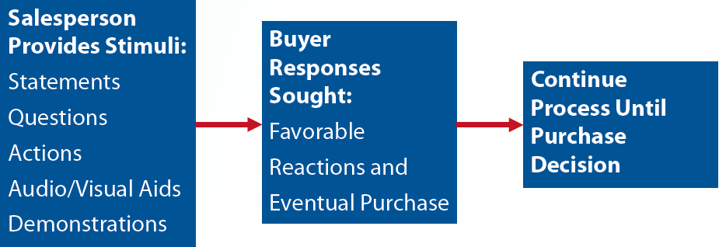
Stimulus Response Selling
Various stimuli elicit predictable responses
Continued affirmation: Series of questions arranged to make the customer say yes to them, until he/she says yes to the entire sales pitch

Slide 14
Mental States Selling or Formula Approach
Assumes that the buyers can be led through a series of mental states in the buying process
AIDA: Mental states
Attention
Interest
Desire
Action

Slide 15
Need Satisfaction Selling
Need satisfaction: Assumes that the customer is buying to satisfy a particular need or set of needs
Involves the salesperson using a probing tactic to uncover important buyer needs

Slide 16
Problem-Solving Selling
Problem solving: Extension of need satisfaction selling
Involves finding alternative solutions for satisfying buyer needs
Notes:
There are 4 rectangular boxes connected by 3 arrows. Starting from the left, the first box contains the text define problem. An arrow originates from this box and points at the next box, which contains the text generate alternative solutions. An arrow originates from this box and points at the next box, which contains the text evaluate alternative solutions. An arrow extends from this box and points at the next, which reads continue selling until purchase decision.

Slide 17
Consultative Selling
Helping customers attain strategic goals by using products, services, and expertise of the selling organization
Role of salespeople
Strategic orchestrator: Arranges the use of the organization’s resources to satisfy the customer
Business consultant: Uses external and internal sources to gather expertise on the customer’s business
Long-term ally: Supports the customer even without the possibility of an immediate sale

Slide 18
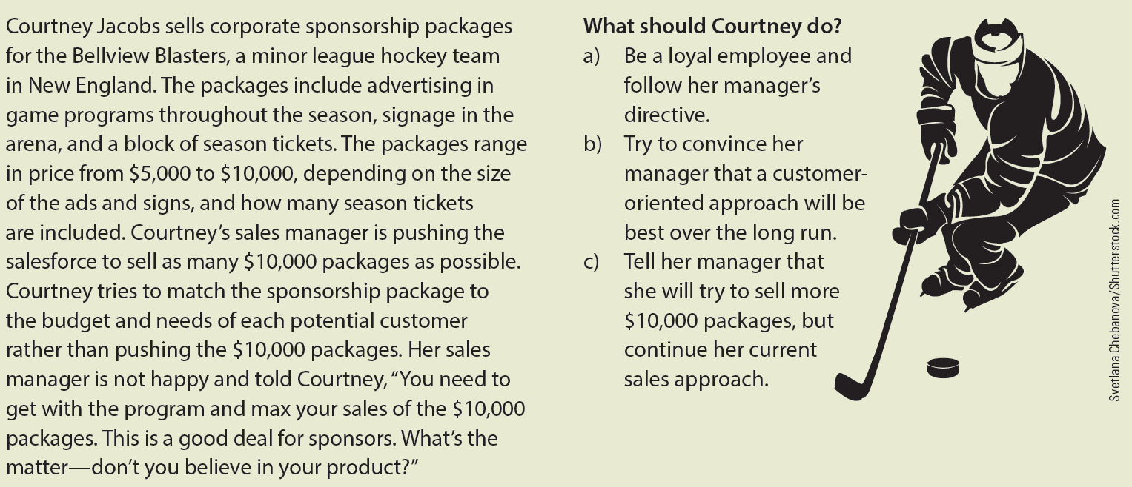
Ethical Dilemma

Slide 19
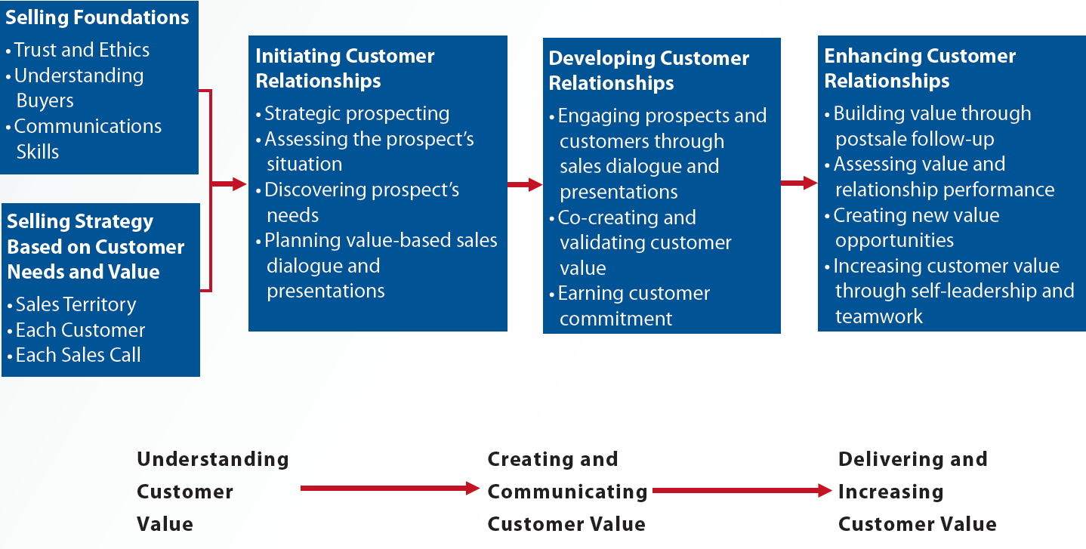
1.4 Trust-Based Sales Process

Slide 20
Characteristics of Sales Careers
Occupational outlook
Advancement opportunities
Immediate feedback
Job variety
Independence
Compensation

Slide 21
Types of Sales Positions
Sales support
New business
Existing business
Missionary salespeople
Detailer
Technical support salespeople
Pioneers
Order-getters
Order-takers
Route salespeople

Slide 22
Types of Sales Positions (continued)
Inside sales
Nonretail salespeople who remain in their employer’s place of business while dealing with customers
Direct-to-consumer sales
Ranges from temporary salesperson to a highly educated person
Combination sales jobs
Perform multiple functions while staying in the same position

Slide 23
Skills and Qualifications Required for Successful Salespeople
Active listening
Service orientation
Oral communication skills
Coordination and problem solving
Dependability
Strategic organizational skills

Slide 24
Skills and Qualifications Required for Successful Salespeople (continued)
Logical reasoning
Written communication skills
Motivation integrity
Initiative
Adaptability

Slide 25
Key Terms
Personal selling
Trust-based relationship selling
Customer value
Sales dialogue
Sales professionalism
Economic stimuli
Diffusion of innovation
Revenue producers
Adaptive selling
Stimulus response selling
Continued affirmation
Mental states selling
AIDA
Need satisfaction selling
Problem-solving selling

Slide 26
Key Terms (continued)
Consultative selling
Strategic orchestrator
Business consultant
Long-term ally
Sales process
Missionary salespeople
Detailer
Technical support salespeople
Pioneers
Order-getters
Order-takers
Inside sales
Combination sales job

Slide 27
nnn
Personal selling relies on interpersonal interactions between buyers and sellers
Trust-based relationship is quite different from traditional selling
Steady increase of complexity in the business world has given rise to sales professionalism
Salespeople can choose alternative personal selling approaches to best interact with their customers
Success in a sales career depends on the individual’s capabilities and his/her career goals

